Slide 1
Chapter 3 Internetworking
Gandeva Bayu Satrya (GBS)
gbs@ittelkom.ac.id
gandeva.bayu.s@gmail.com
TELKOM ENGINEERING SCHOOL
Telkom University

Slide 2
Agenda
Chapter 3. Internetworking
3.1 Switching and Bridging
VCI, bridge (STP)
3.2 Basic Internetworking
Class IP, Subneting, ARP, DHCP, ICMP
3.3 Routing
Routing, Distance Vector, Link State

Slide 3
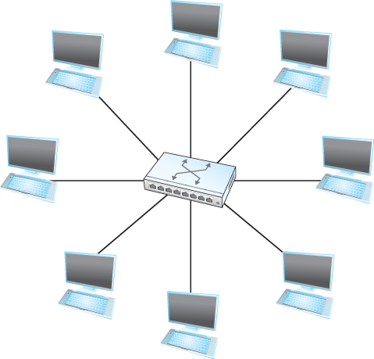
Switching and Forwarding
SWITCH
A mechanism that allows us to interconnect links to form a large network.
A multi-input, multi-output device which transfers packets from an input to one or more outputs.
Every host on a switched network has its own link to the switch.
A switch’s primary job is to receive incoming packets on one of its links and to transmit them on some other link

Slide 4
Switching and Forwarding
How does the switch decide which output port to place each packet on?
It looks at the header of the packet for an identifier that it uses to make the decision
Two common approaches
Datagram or Connectionless Approach.
Virtual circuit or Connection-oriented Approach.
A third approach source routing is less common.

Slide 5
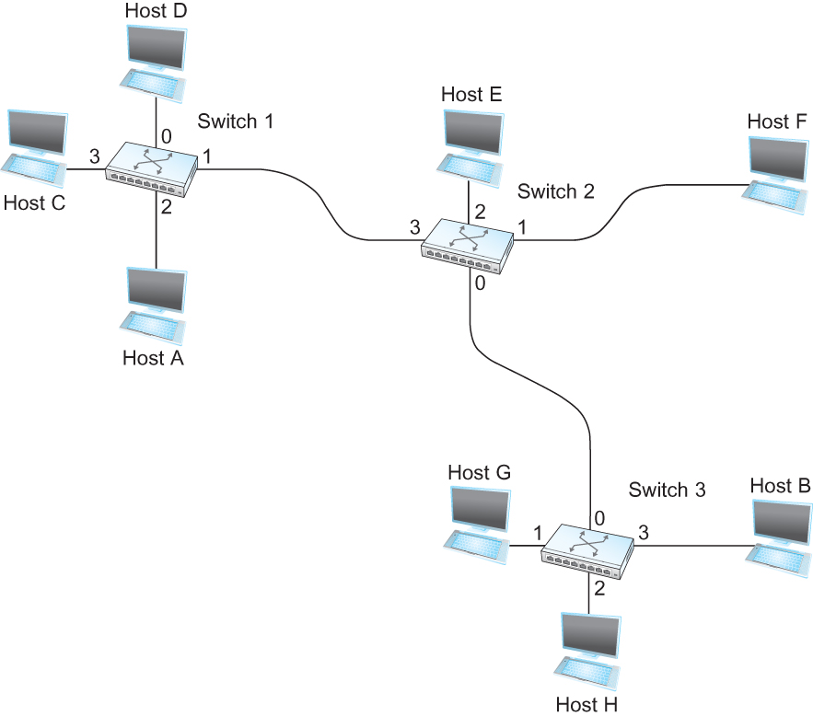
a. Datagram Approach
Every packet contains enough information to enable any switch to decide how to get it to destination
To decide how to forward a packet, a switch consults a forwarding table (sometimes called a routing table)
Destination Port
-------------------------
A 3
B 0
C 3
D 3
E 2
F 1
G 0
H 0
Forwarding Table for Switch 2

Slide 6
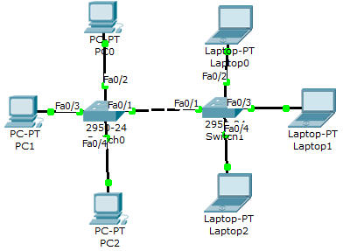
MAC Add Table in CISCO
GBS_SW#sh mac-address-table
Mac Address Table
-------------------------------------------
Vlan Mac Address Type Ports
---- ----------- -------- -----
1 0009.7cba.c915 DYNAMIC Fa0/1
1 000b.be7a.69bc DYNAMIC Fa0/3
1 0030.a368.e65a DYNAMIC Fa0/1
1 0060.2f58.3453 DYNAMIC Fa0/4
1 0060.5c94.ee01 DYNAMIC Fa0/1
1 0060.7083.2b34 DYNAMIC Fa0/1
1 00e0.a3bc.03a8 DYNAMIC Fa0/2
GBS_SW#
Which CLIENT...?
Notes:
Question :
Berapakah MAC-add untuk PC-2 (bawah)???

Slide 7
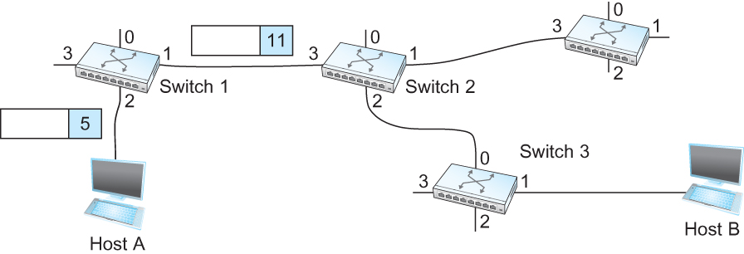
b. Virtual-Circuit Approach
Virtual Circuit Switching
Widely used technique for Packet Switching
Uses the concept of Virtual Circuit (VC)
Also called a connection-oriented model
First set up a virtual connection from the source host to the destination host and then send the data

Slide 8
VCI
 | In Int | In VCI | Out Int | Out VCI
SW-1 | 2 | 5 | 1 | 11
SW-2 | 3 | 11 | 2 | 7
SW-3 | 0 | 7 | 1 | 4

Slide 9
Switching and Forwarding
Comparison with the Datagram Model
Datagram network has no connection establishment phase and each switch processes each packet independently
Each arriving packet competes with all other packets for buffer space
If there are no buffers, the incoming packet must be dropped
In VC, we could imagine providing each circuit with a different quality of service (QoS)
The network gives the user some kind of performance related guarantee
Most popular examples of VC technologies are Frame Relay and ATM
One of the applications of Frame Relay is the construction of VPN

Slide 10
Switching and Forwarding
ATM (Asynchronous Transfer Mode)
Connection-oriented packet-switched network
Packets are called cells
5 byte header + 48 byte payload
Fixed length packets are easier to switch in hardware
Simpler to design
Enables parallelism

Slide 11
Switching and Forwarding
ATM
User-Network Interface (UNI)
Host-to-switch format
GFC: Generic Flow Control
VCI: Virtual Circuit Identifier
Type: management, congestion control
CLP: Cell Loss Priority
HEC: Header Error Check (CRC-8)
Network-Network Interface (NNI)
Switch-to-switch format
GFC becomes part of VPI field

Slide 12
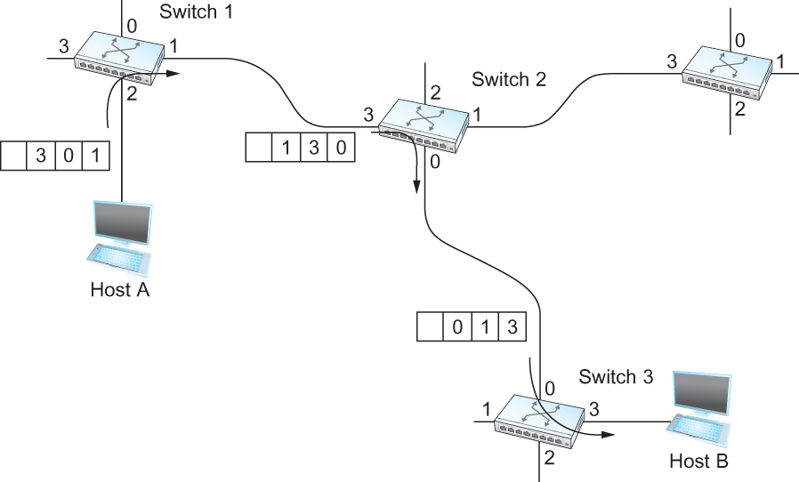
c. Source Routing
Source Routing
All the information about network topology that is required to switch a packet across the network is provided by the source host

Slide 13
Agenda
Chapter 3. Internetworking
3.1 Switching and Bridging
VCI, bridge (STP)
3.2 Basic Internetworking
Class IP, Subneting, ARP, DHCP, ICMP
3.3 Routing
Routing, Distance Vector, Link State

Slide 14
Bridges and LAN Switches
Class of switches that is used to forward packets between shared-media LANs such as Ethernets
Known as LAN switches
Referred to as Bridges
Suppose you have a pair of Ethernets that you want to interconnect
One approach is put a repeater in between them
An alternative would be to put a node between the two Ethernets and have the node forward frames from one Ethernet to the other
This node is called a Bridge
A collection of LANs connected by one or more bridges is usually said to form an Extended LAN

Slide 15
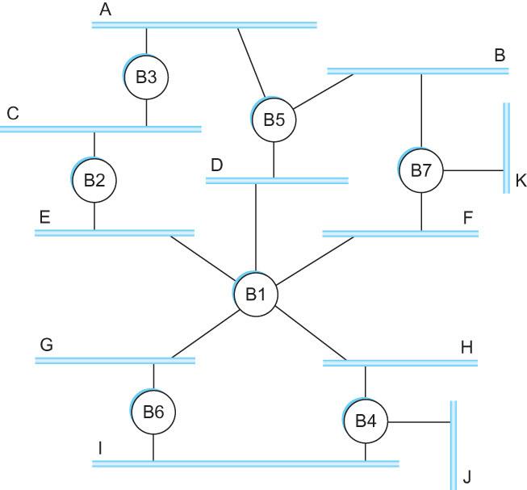
Bridges and LAN Switches
Strategy works fine if the extended LAN does not have a loop in it
Why?
Frames potentially loop through the extended LAN forever
B1, B4, and B6
B1, B2, B3, and B5
B1, B5, and B7

Slide 16
Bridges and LAN Switches
How does an extended LAN come to have a loop in it?
Network is managed by more than one administrator
For example, it spans multiple departments in an organization
Loops are built into the network to provide redundancy in case of failures
Solution :
Spanning Tree Algorithm
Switch with Spanning Tree Protocol (STP)

Slide 17
Spanning Tree Algorithm
Algorithm selects ports as follows:
Each bridge has a unique identifier
Elect the bridge with the smallest id as The Root of the spanning tree
The root bridge always forwards frames out over all of its ports
Each bridge computes the shortest path to the root and notes which of its ports is on this path
Finally, all the bridges connected to a given LAN elect a single designated bridge that will be responsible for forwarding
Each LAN’s designated bridge is the one that is closest to the root
If two or more bridges are equally close to the root, smallest id
Each bridge is connected to more than one LAN

Slide 18
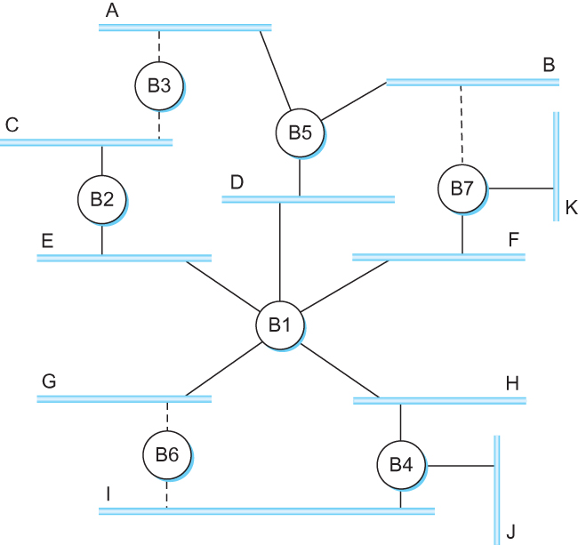
Spanning Tree Algorithm
B1 is the root bridge
B3 and B5 are connected to LAN A, but B5 is the designated bridge
B5 and B7 are connected to LAN B, but B5 is the designated bridge

Slide 19
Spanning Tree Algorithm
Even after the system has stabilized, the root bridge continues to send configuration messages periodically
Other bridges continue to forward these messages
When a bridge fails, the downstream bridges will not receive the configuration messages
After waiting a specified period of time, they will once again claim to be the root and the algorithm starts again

Slide 20
Agenda
Chapter 3. Internetworking
3.1 Switching and Bridging
VCI, bridge (STP)
3.2 Basic Internetworking
Class IP, Subneting, ARP, DHCP, ICMP
3.3 Routing
Routing, Distance Vector, Link State

Slide 21
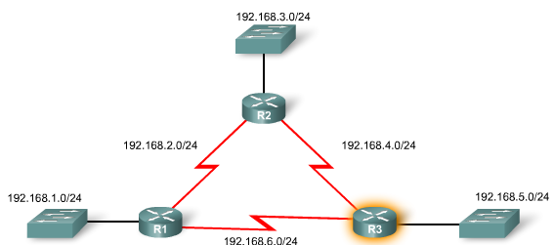
Internetworking
CISCO, 2008
Internetworking…
is An arbitrary collection of networks interconnected (IP) to provide some sort of host-host to packet delivery service.
Notes:
Difference internet and Internet???
We use the term internetwork, or sometimes just internet with a lowercase i, to refer to an arbitrary collection of networks interconnected to provide some sort of host-to-host packet delivery service. For example, a
corporation with many sites might construct a private internetwork by interconnecting the LANs at their different sites with point-to-point links leased from the phone company.
When we are talking about the widely used global internetwork to which a large percentage of networks are now connected, we call it the Internet with a capital I.

Slide 22
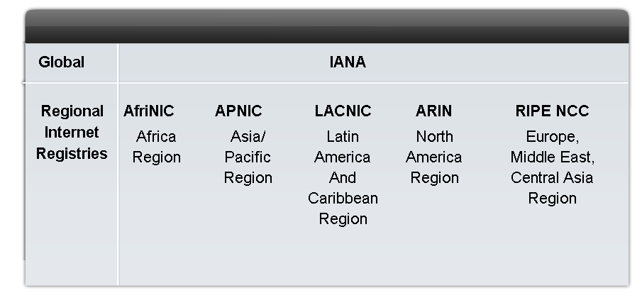
Assigning Addresses
Describe the process for requesting IP public addresses, the role ISPs play in the process, and the role of the regional agencies that manage IP address registries
Notes:
An IP address is an address used to uniquely identify a device on an IP network. The address is made up of 32 binary bits which can be divisible into a network portion and host portion with the help of a subnet mask.

Slide 23
Internet Protocols
What is IP
IP stands for Internet Protocol
Key tool used today to build scalable, heterogeneous internetworks
It runs on all the nodes in a collection of networks and defines the infrastructure that allows these nodes and networks to function as a single logical internetwork
Internet Protocols
IPv4
IPv6 (wait... chapter 4)

Slide 24
IP Fragmentation & Reassembly
Each network has some MTU (Maximum Transmission Unit)
Ethernet (1500 bytes), FDDI (4500 bytes)
Strategy
Fragmentation occurs in a router when it receives a datagram that it wants to forward over a network which has (MTU < datagram)
Reassembly is done at the receiving host
All the fragments carry the same identifier in the Ident field
Fragments are self-contained datagrams
IP does not recover from missing fragments

Slide 25
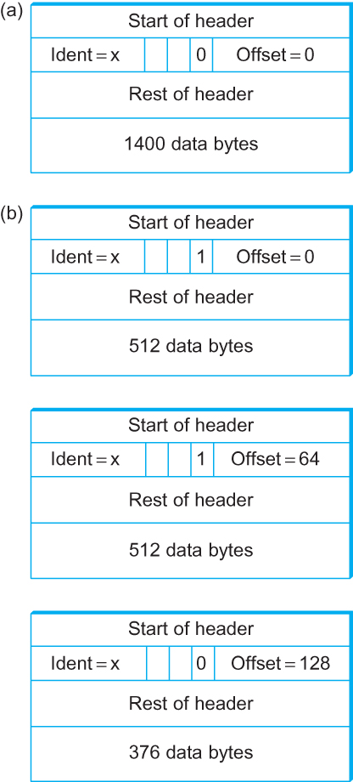
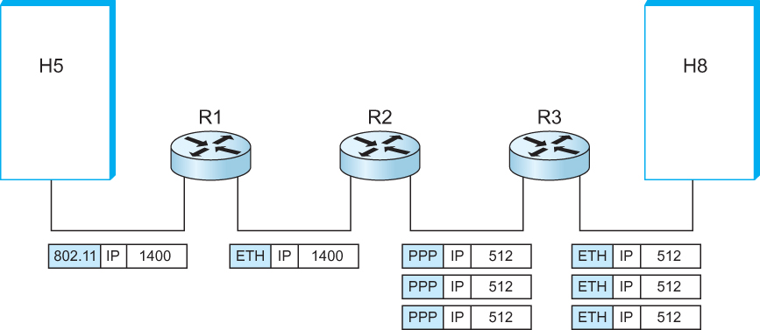
IP Fragmentation & Reassembly

Slide 26
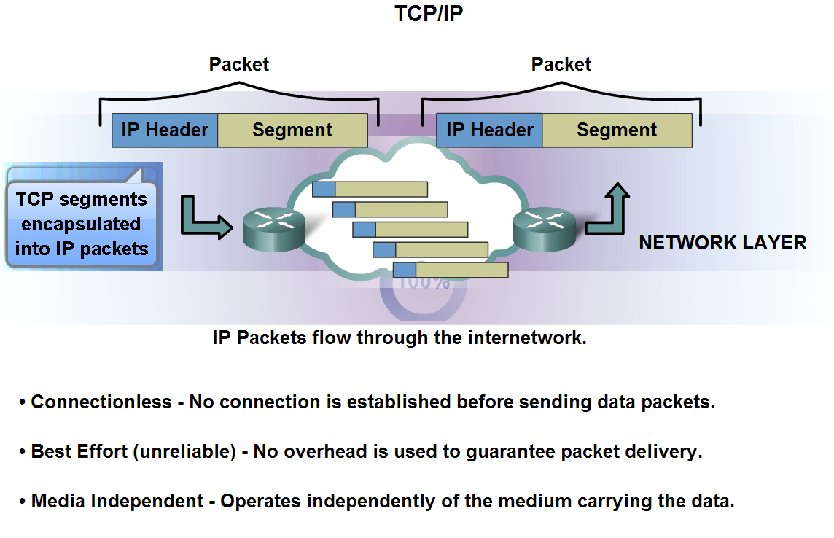
Role of IPv4 Protocols
CISCO, 2008

Slide 27
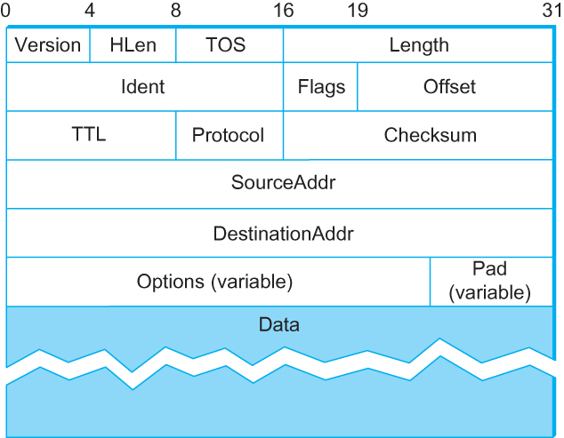
IPv4 Format

Slide 28
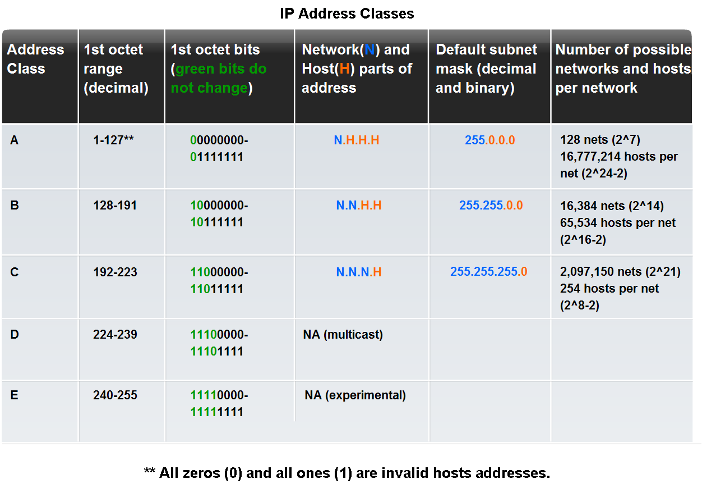
IPv4 Class

Slide 29
IPv4
Define public address and private address
The private address blocks are:
10.0.0.0 to 10.255.255.255 (10.0.0.0 /8)
172.16.0.0 to 172.31.255.255 (172.16.0.0 /12)
192.168.0.0 to 192.168.255.255 (192.168.0.0 /16)

Slide 30
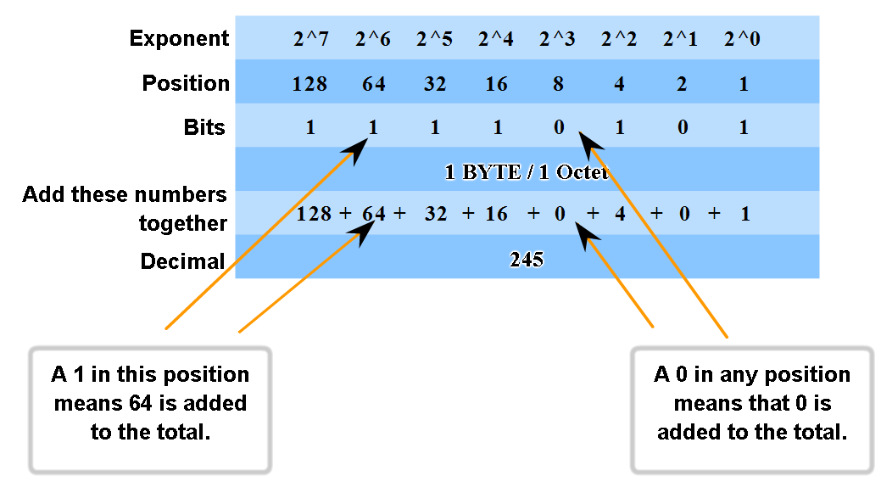
IPv4 Convert

Slide 31
Subnetting
Subnetting provides a ﬁrst step to reducing total number of network numbers that are assigned.
Easy for Managed and Decrease of Using IP.
Add another level to address/routing hierarchy: subnet
What is…
Network/Subnet : ID parent
Host/client/node : Childs
Gateway (GW) : IP add on Router (1st allocation IP)
Broadcast (BC) : IP add on Switch (Last allocation IP)
Prefix/ “/” : how many bit are Used (#of bit 1)
Subnet Mask (SM) : Binary of Prefix

Slide 32
Subnetting
How many Subnet and Hosts?
Number of subnets available=
2^{number-of-bits-1}-2
(***subnet zero and subnet extended***)
Number of hosts per subnet available=
2^{number-of-bits-0}-2
(***gateway and broadcast***)

Slide 33
Subnetting (Ex.1)
CCNA International Exam, 2012
Given the address 192.168.20.19/28, which of the following are valid host addresses on this subnet?
A. 192.168.20.29
B. 192.168.20.16
C. 192.168.20.17
D. 192.168.20.31
E. 192.168.20.0
11111111. 11111111. 11111111.11110000
^
2⁴=16
192.168.20.16 ………………………………………………. 192.168.20.31
.17 .30

Slide 34
Subnetting (Ex.2)
CCNA International Exam, 2012
Refer to the exhibit. The user at Workstation B reports that Server A cannot be reached. What is preventing Workstation B from reaching Server A?
A. The IP address for Server A is a broadcast address.
B. The IP address for Workstation B is a subnet address.
C. The gateway for Workstation B is not on the same subnet.
D. The gateway for Server A is not on the same subnet.

Slide 35
Subnetting (Ex.3)
CCNA International Exam, 2012
Refer to the exhibit. All of the routers in the network are configured with the IP Subnet-Zero command. Which network addresses should be used for Link A and Network A? (Choose two.)
A. Network A - 172.16.3.48/26
B. Network A - 172.16.3.128/25
C. Network A - 172.16.3.192/26
D. Link A - 172.16.3.0/30
E. Link A - 172.16.3.40/30
F. Link A - 172.16.3.112/30

Slide 37
Supernetting
Supernetting/CIDR/VLSM
Classless Inter-Domain Routing
Variable Length Subnet Mask
Prefix Aggregation a.k.a. Route Summarization
A technique that addresses two scaling concerns in the Internet
The growth of backbone routing table as more and more network numbers need to be stored in them
Potential exhaustion of the 32-bit address space
Address assignment efficiency
Arises because of the IP address structure with class A, B, and C addresses

Slide 38
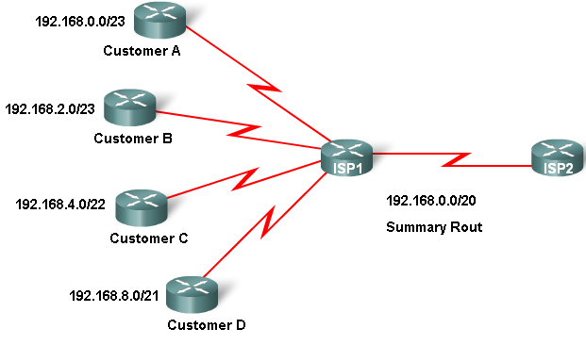
Supernetting [Ex.1]
CISCO, 2008

Slide 39
Supernetting
192.168.0.0/23 00000000
192.168.2.0/23 00000010
192.168.4.0/22 00000100
192.168.8.0/21 00001000
---------------------------------------
00000000
192.168.0.0/20 ← Route Summarization

Slide 40
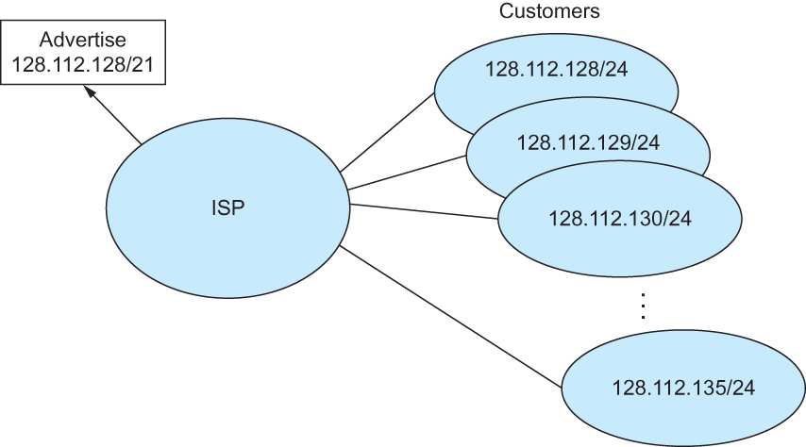
Supernetting [Ex.2]

Slide 41
Agenda
Chapter 3. Internetworking
3.1 Switching and Bridging
VCI, bridge (STP)
3.2 Basic Internetworking
Class IP, Subneting, ARP, DHCP, ICMP
3.3 Routing
Routing, Distance Vector, Link State

Slide 42
ARP
Map IP addresses into physical addresses
destination host
next hop router
Techniques
encode physical address in host part of IP address
table-based
ARP (Address Resolution Protocol)
table of IP to physical address bindings
broadcast request if IP address not in table
target machine responds with its physical address
table entries are discarded if not refreshed (ARP cache)

Slide 43
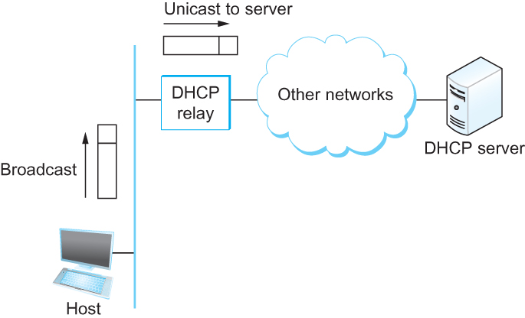
DHCP
Drawbacks of manual configuration
A lot of work to configure all the hosts in a large network
Configuration process is error-prune
Automated Configuration Process is required
DHCP server is responsible for providing configuration information to hosts
There is at least one DHCP server for an administrative domain
DHCP server maintains a pool of available addresses

Slide 44
ICMP
Internet Control Message Protocol (ICMP)
Defines a collection of error messages that are sent back to the source host whenever a router or host is unable to process an IP datagram successfully
Destination host unreachable due to link /node failure
Reassembly process failed
TTL had reached 0 (so datagrams don't cycle forever)
IP header checksum failed
ICMP-Redirect
From router to a source host
With a better route information

Slide 45
Agenda
Chapter 3. Internetworking
3.1 Switching and Bridging
VCI, bridge (STP)
3.2 Basic Internetworking
Class IP, Subneting, ARP, DHCP, ICMP
3.3 Routing
Routing, Distance Vector, Link State

Slide 46
Routing
Forwarding versus Routing
Forwarding:
to select an output port based on destination address and routing table
Routing:
process by which routing table is built

Slide 47
Routing Table
Forwarding table VS Routing table
Forwarding table
Used when a packet is being forwarded and so must contain enough information to accomplish the forwarding function
A row in the forwarding table contains the mapping from a network number to an outgoing interface and some MAC information, such as Ethernet Address of the next hop
Routing table
Built by the routing algorithm as a precursor to build the forwarding table
Generally contains mapping from network numbers to next hops

Slide 48
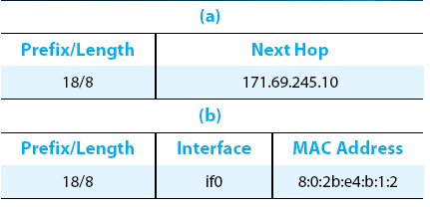
Example
Example rows from (a) routing and (b) forwarding tables

Slide 49
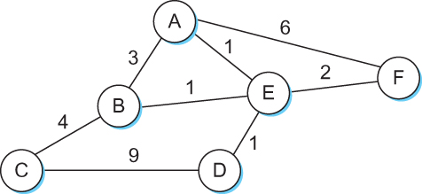
Routing Example
Network as a Graph
The basic problem of routing is to find the lowest-cost path between any two nodes
Where the cost of a path equals the sum of the costs of all the edges that make up the path.

Slide 50
Routing Protocol

Slide 51
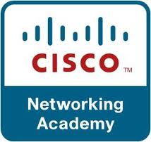
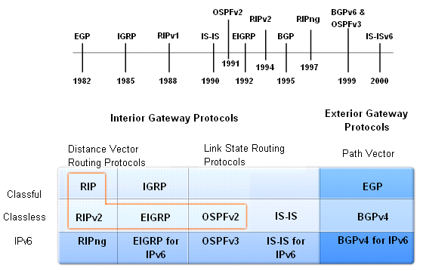
Routing Protocol Evolution

Slide 52
Agenda
Chapter 3. Internetworking
3.1 Switching and Bridging
VCI, bridge (STP)
3.2 Basic Internetworking
Class IP, Subneting, ARP, DHCP, ICMP
3.3 Routing
Routing, Distance Vector, Link State

Slide 53
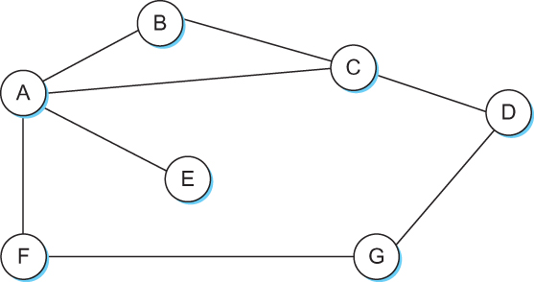
Distance Vector
Each node constructs a one dimensional array (a vector) containing the “distances” (costs) to all other nodes and distributes that vector to its immediate neighbors.
Starting assumption is that each node knows the cost of the link to each of its directly connected neighbors.
Each router maintains a table of [Destination, Cost, NextHop] tuples, and exchanges a list of (Destination, Cost) pairs with its directly connected neighbors.

Slide 54
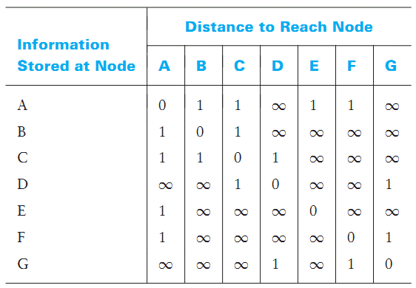
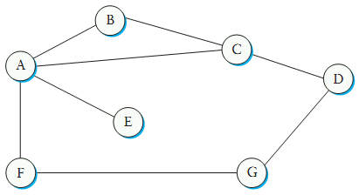
Distance Vector

Slide 55
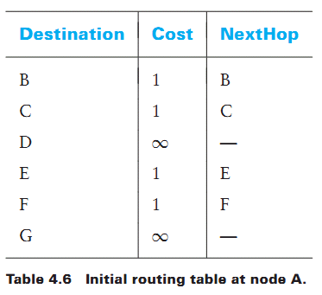
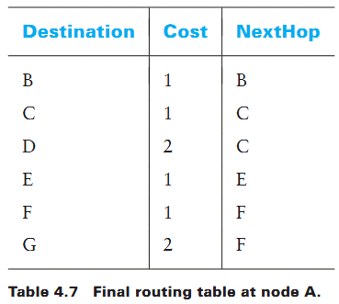
Distance Vector

Slide 56
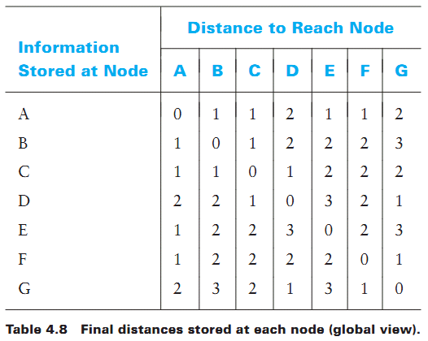
Distance Vector
COMPLETE

Slide 57
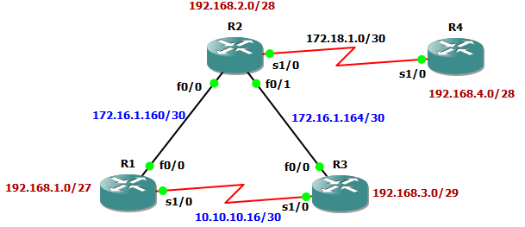
DV Example : RIP
R1(config)# router rip
R1(config-router)# net 192.168.1.0
R1(config-router)# net 172.16.1.160
R1(config-router)# net 10.10.10.16
R1# show ip route 172.16.0.0/30 is subnetted, 2 subnets R 172.16.1.164 [120/1] via 172.16.1.162, 00:00:09, FastEthernet0/0 C 172.16.1.160 is directly connected, FastEthernet0/0 R 172.18.0.0/16 [120/1] via 172.16.1.162, 00:00:09, FastEthernet0/0 R 192.168.4.0/24 [120/2] via 172.16.1.162, 00:00:09, FastEthernet0/0 10.0.0.0/30 is subnetted, 1 subnets C 10.10.10.16 is directly connected, Serial1/0 192.168.1.0/27 is subnetted, 1 subnets C 192.168.1.0 is directly connected, Loopback1 R 192.168.2.0/24 [120/1] via 172.16.1.162, 00:00:11, FastEthernet0/0 R 192.168.3.0/24 [120/1] via 10.10.10.18, 00:00:03, Serial1/0

Slide 58
Link State Routing
Each node is assumed to be capable of finding out the state of the link to its neighbors (up or down) and the cost of each link.
Every node knows how to reach its directly connected neighbors, and if we make sure that the totality of this knowledge is disseminated to every node, then every node will have enough knowledge of the network to build a complete map of the network.

Slide 59
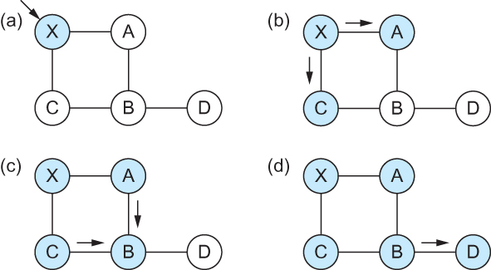
Link State Routing
Reliable Flooding
Flooding of link-state packets. (a) LSP arrives at node X; (b) X floods LSP to A and C; (c) A and C flood LSP to B (but not X); (d) flooding is complete

Slide 60
Shortest Path Routing
The algorithm works as follows:
Initialize the Confirmed list with an entry for myself; this entry has a cost of 0.
For the node just added to the Confirmed list in the previous step, call it node Next and select its LSP.
For each neighbor (Neighbor) of Next, calculate the cost (Cost) to reach this Neighbor as the sum of the cost from myself to Next and from Next to Neighbor.
If the Tentative list is empty, stop. Otherwise, pick the entry from the Tentative list with the lowest cost, move it to the Confirmed list, and return to step 2.

Slide 61
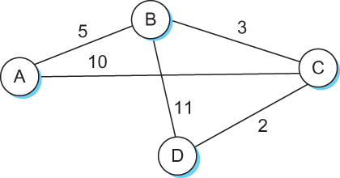
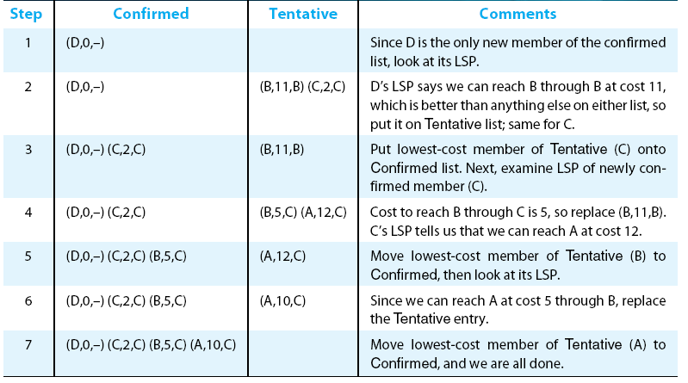
Shortest Path Routing

Slide 62
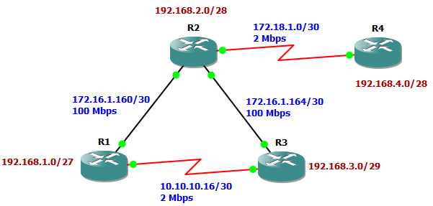
LS Example : OSPF
R1# sh ip route
172.16.0.0/30 is subnetted, 2 subnets
O 172.16.1.164 [110/2] via 172.16.1.162, 00:00:02, FastEthernet0/0
C 172.16.1.160 is directly connected, FastEthernet0/0
172.18.0.0/30 is subnetted, 1 subnets
O IA 172.18.1.0 [110/65] via 172.16.1.162, 00:00:02, FastEthernet0/0
192.168.4.0/32 is subnetted, 1 subnets
O IA 192.168.4.1 [110/66] via 172.16.1.162, 00:00:02, FastEthernet0/0
10.0.0.0/30 is subnetted, 1 subnets
C 10.10.10.16 is directly connected, Serial1/0
192.168.1.0/27 is subnetted, 1 subnets
C 192.168.1.0 is directly connected, Loopback1
192.168.2.0/32 is subnetted, 1 subnets
O 192.168.2.1 [110/2] via 172.16.1.162, 00:00:04, FastEthernet0/0
192.168.3.0/32 is subnetted, 1 subnets
O 192.168.3.1 [110/3] via 172.16.1.162, 00:00:06, FastEthernet0/0

Slide 63
Task Chapter 3
[Bahasa/handwriting]
[Deadline-03/10/13]
[12.01pm]
No. 1 : Exercise Chapter 3, Peterson 5th Ed. Page 294, no. 46!
No. 2 : Exercise Chapter 3, Peterson 5th Ed. Page 295, no. 48!

Slide 64
Bibliography
Kurose, J.F., and Ross, K.W., Computer Networking : A Top-Down Approach Sixth Edition, Pearson Education, Inc. USA, 2013.
Lammle T., Cisco Certified Network Associate : Study Guide Fifth Edition, Sybex, Inc. USA, 2005.
Peterson, L.L., and Davie, B.S., Computer Networks: A Systems Approach Fifth Edition, Morgan Kaufmann, Burlington USA, 2012.
Tanenbaum, A.S., and Wetherall, D.J., Computer Networks Fifth Edition, Pearson Education, Inc., Boston USA, 2011.

Slide 65
THANK YOU
Gandeva Bayu Satrya (GBS)
gbs@ittelkom.ac.id
gandeva.bayu.s@gmail.com
TELKOM ENGINEERING SCHOOL
Telkom University

